Slide 1

Datasets and Examples exploration

Slide 2

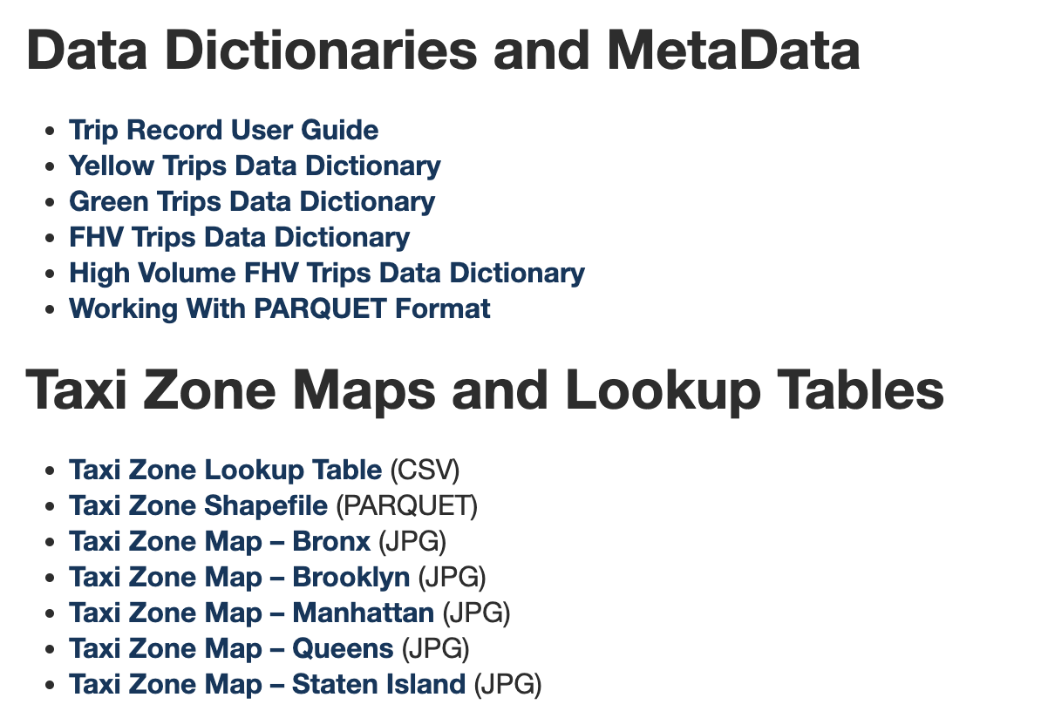
Taxi Trip Record Data
Very popular for Data experiments
Simple and tons of public examples; e.g. Kaggle
Data source: nyc.gov/site/tlc/about/tlc-trip-record-data.page

Slide 3
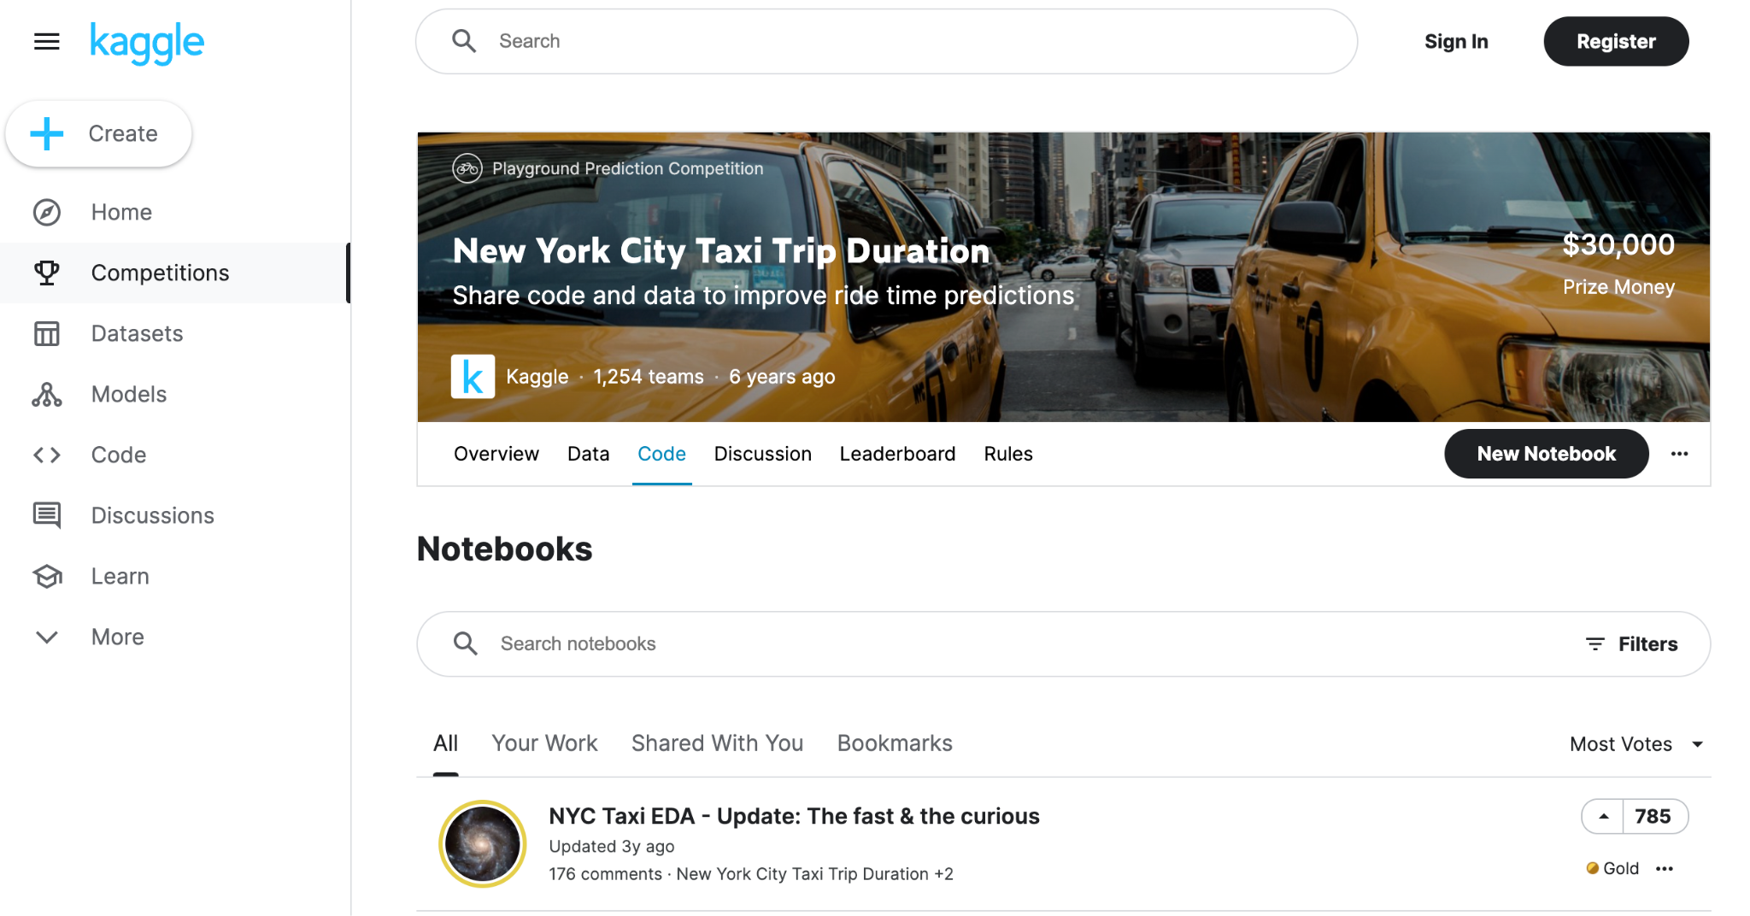
Learn by Building simple examples
Different data formats
e.g. CSV, Parquet
Different IDE
e.g. VS Code, Jupyter
Different platforms
e.g. local, AWS (Optional)
Different scenarios
e.g. batch, streaming, troubleshooting

Slide 4
Next…

